Slide 1
Library management
Student name:Manpreet kaur (199666160)

Slide 2
About project: Library Management is a website in which a student can search about books. student can also edit, delete and upload a picture of book. In this website a student can check the total page and cost of a book with the name of author.
About PHP: PHP stands for hypertext pre-processor and it used to known for personal home pages. It is use to create static websites, dynamic website and web applications.
PHP codes are processed by a PHP interpreter implicate as a module in a web server.
PHP Is a programming language which is designed for web development.
About cypress: It is a testing tool which is built for modern web. It mostly
Compare to selenium.
It help user to write faster, easier and more reliable tests.
It is a automation tool in which a user can write about End-to-End tests, integration tests and unit tests.

Slide 3
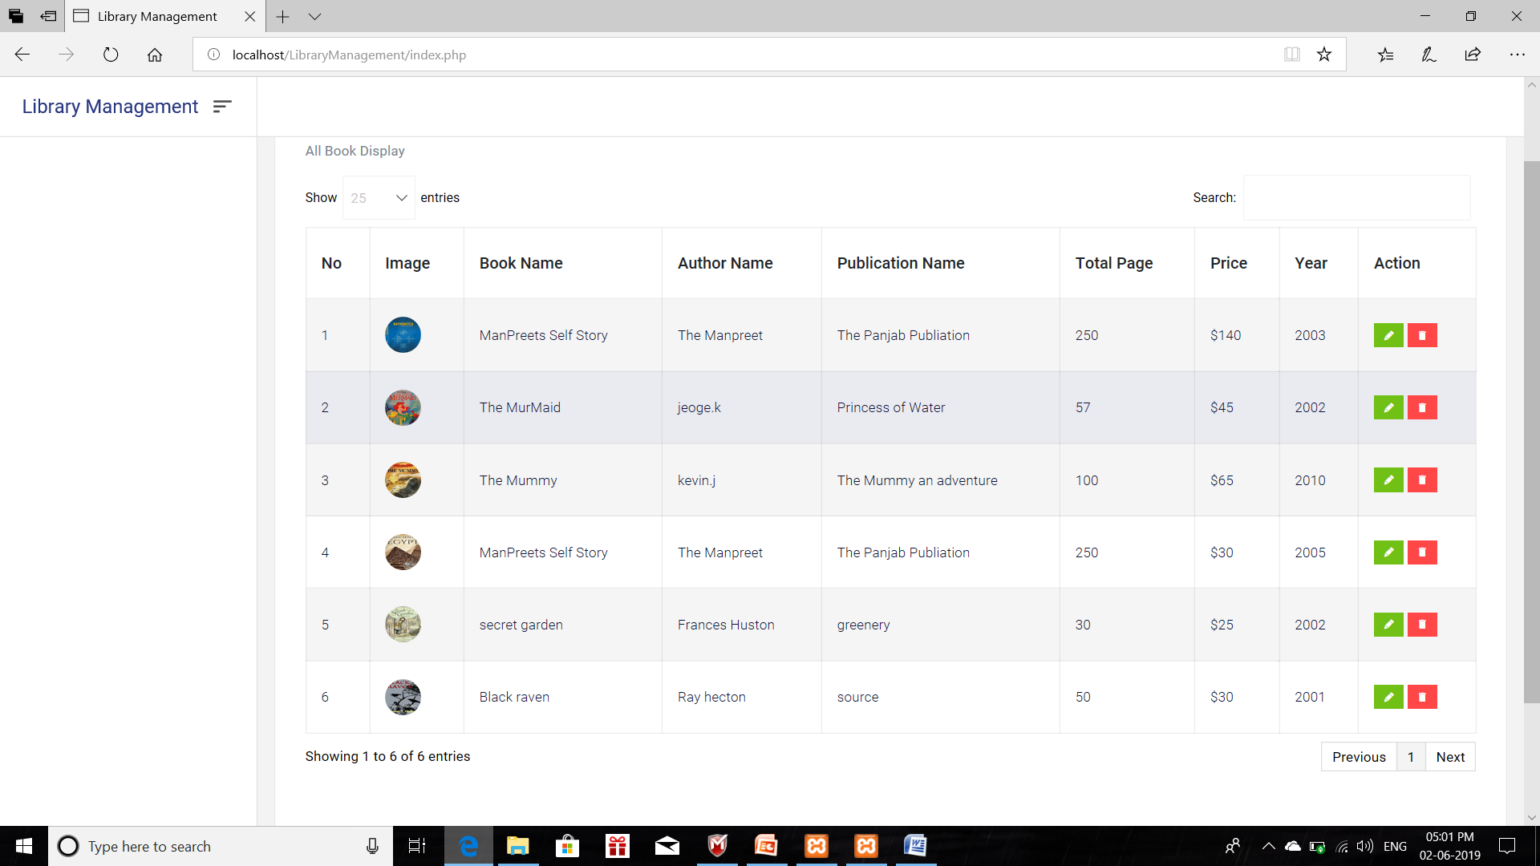
Screen shots of website
Home page of website

Slide 4
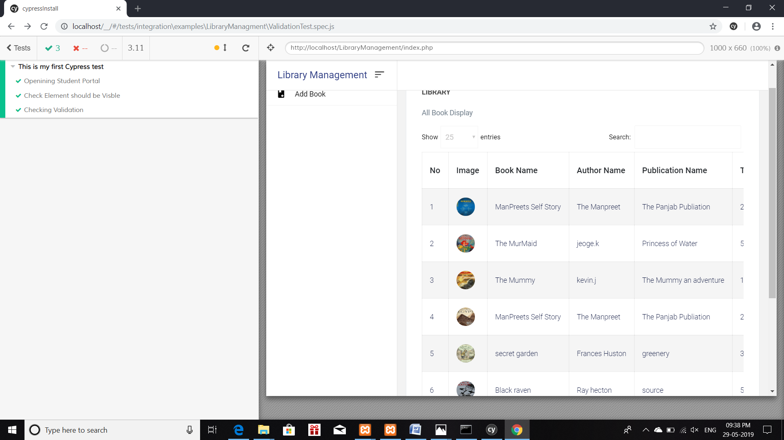
Test cases of website
Testing validation in library management: Test pass

Slide 5
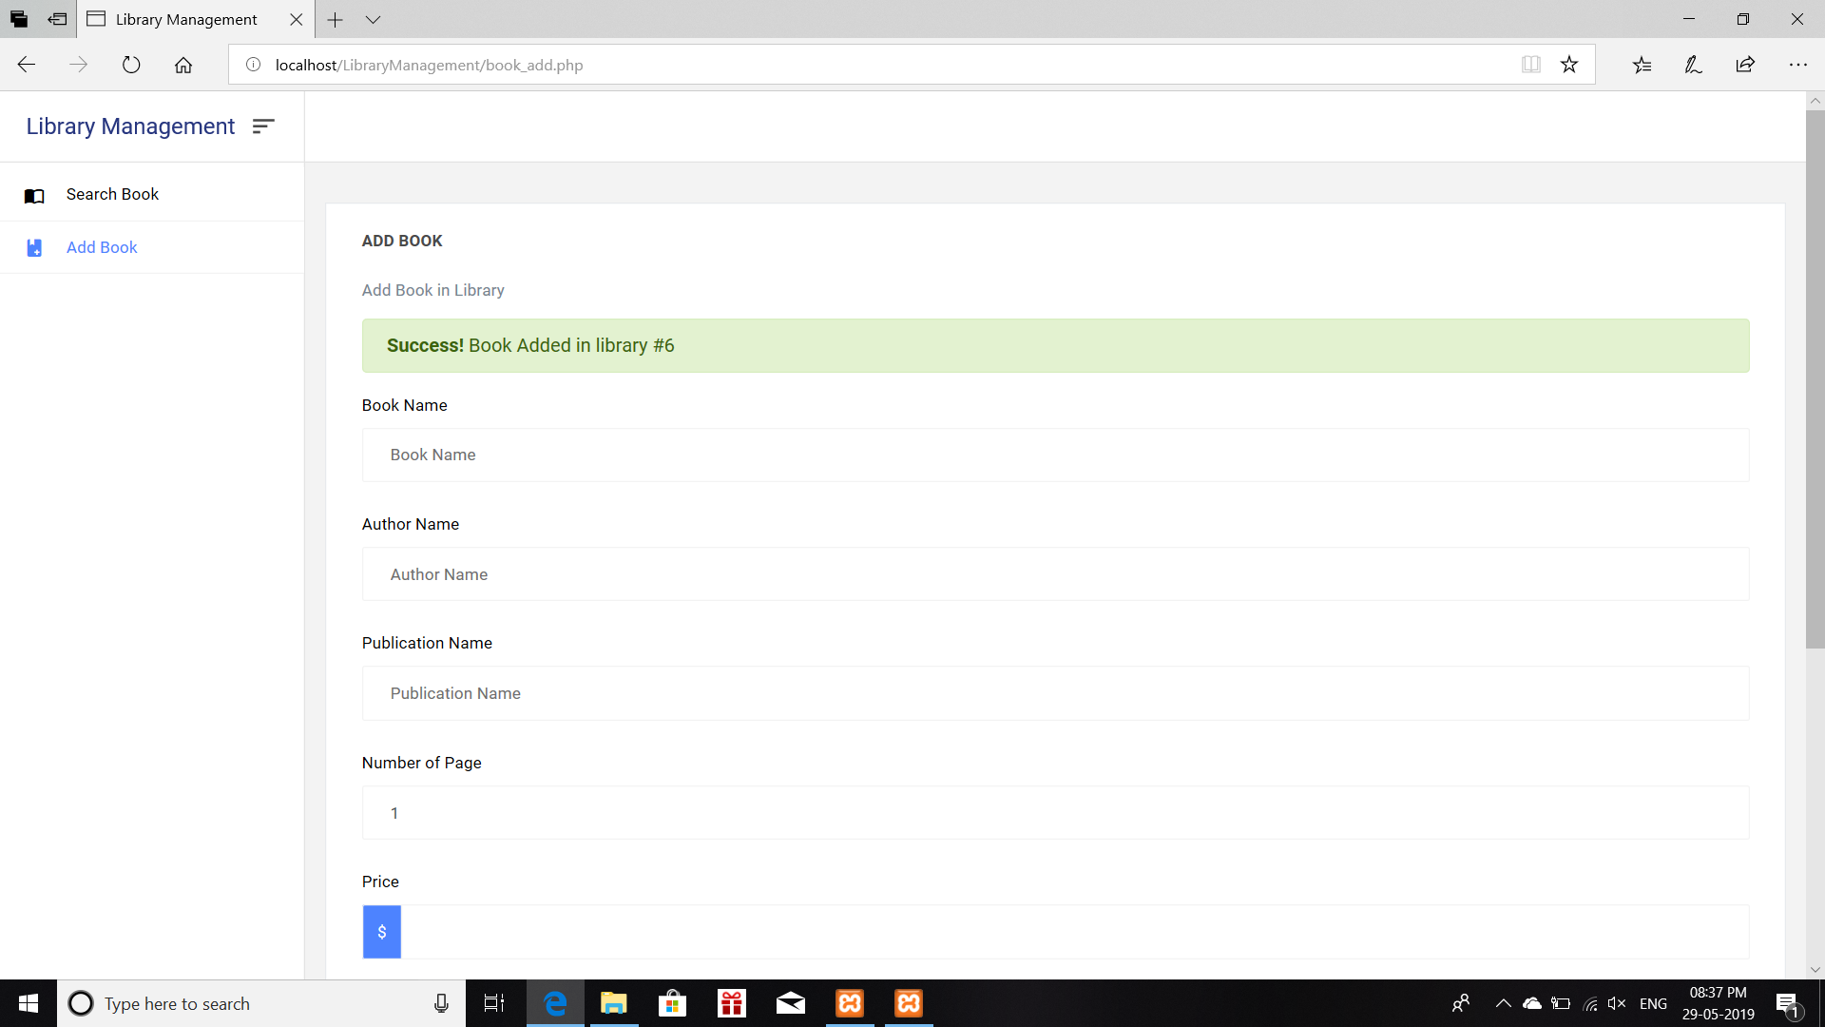
Edit current books: Test pass

Slide 6
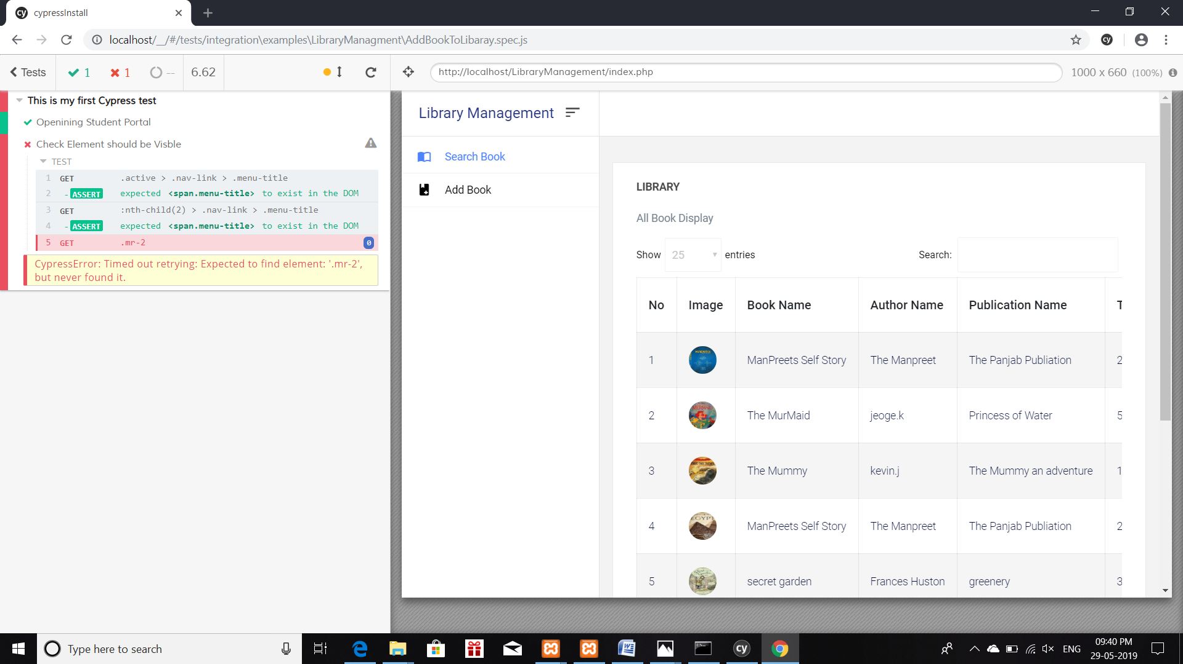
Add Book to Library: Test Pass
Pipe line: job is not created because server is not available. It also shows error
to open Jenkins account.

Slide 7
THANK YOU

